Slide 1
To add Users to your Dashboard license:
Log in to https://smartconstruction.mykomatsu.com and select “My subscription”

Slide 2
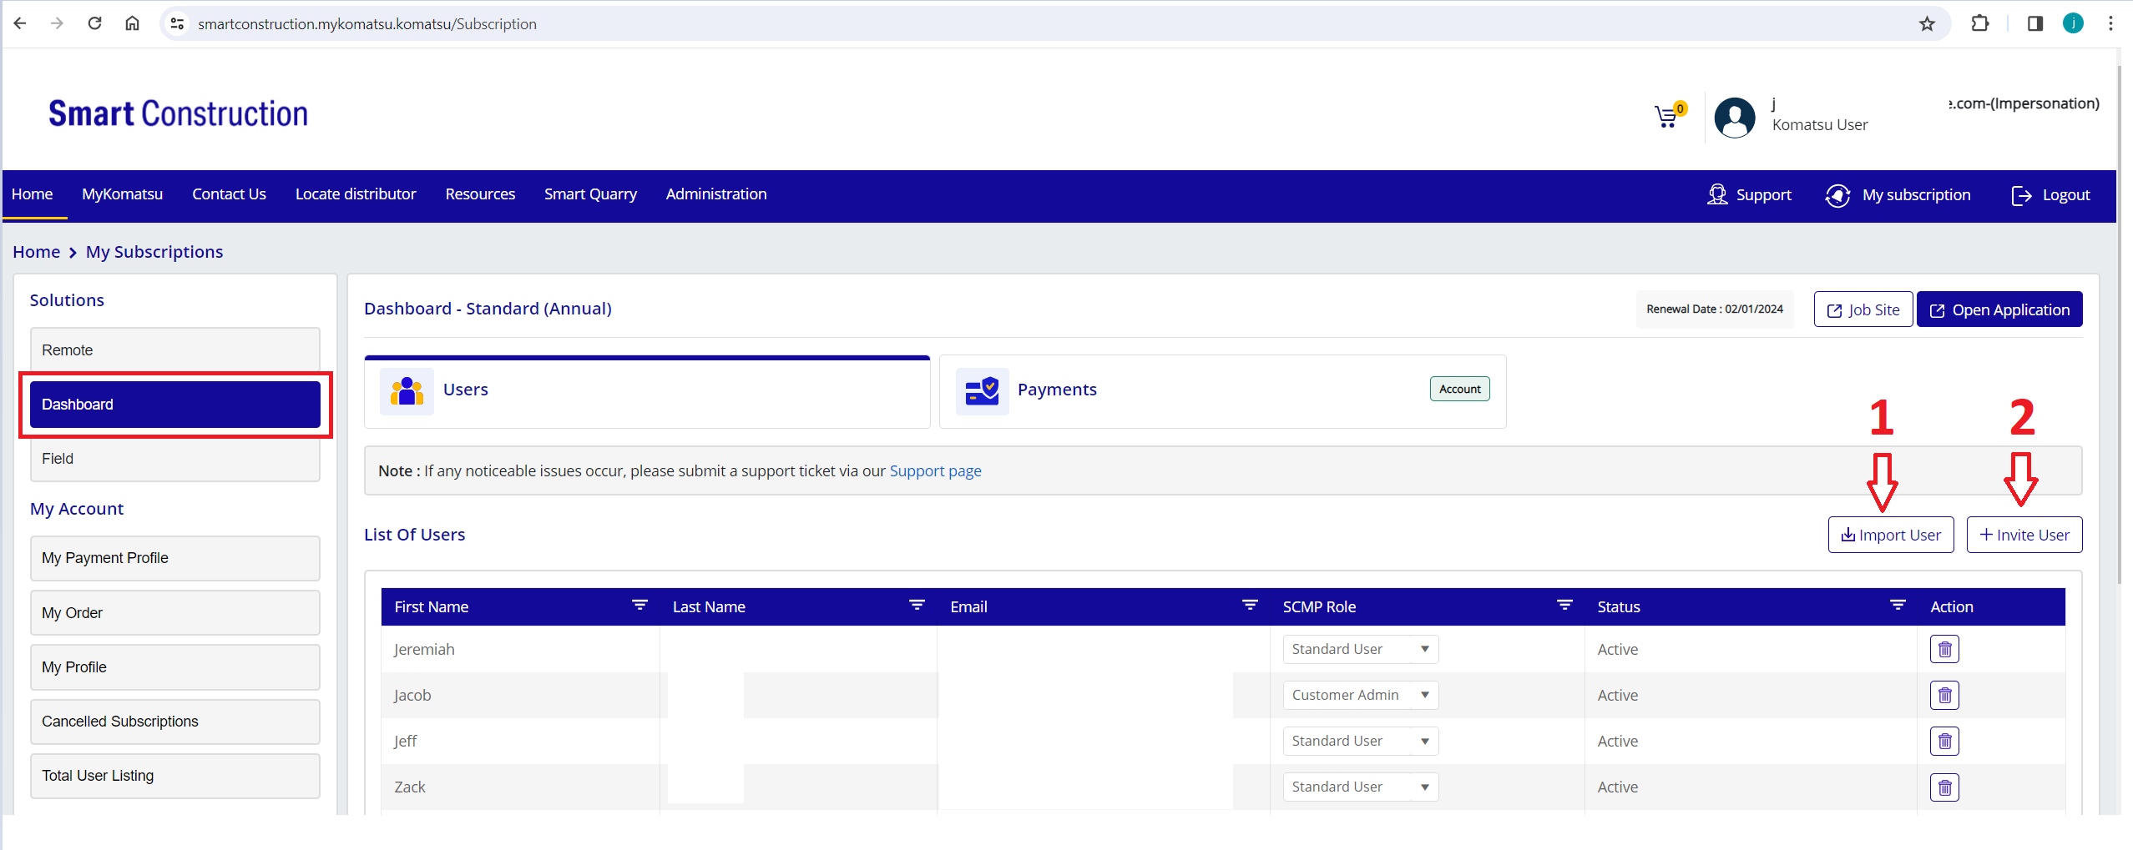
Next ensure Dashboard is selected under Solutions on the left panel.
To add a user to your Dashboard license select either Import User or +Invite User.
- Select Import User if the person already has a My Komatsu account and select them from the List.
-Select + Invite User if they DO NOT already have a My Komatsu account.

Slide 3
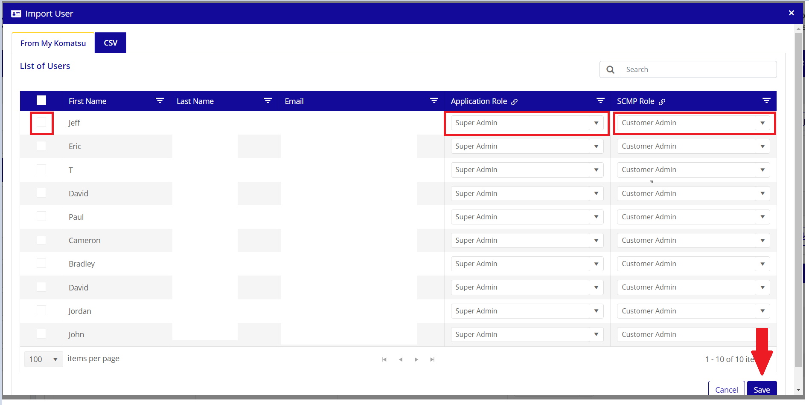
To Import a User that already has a My Komatsu account:
Select the User and define their role within Dashboard and on the Smart Construction MarketPlace
Click Save

Slide 4
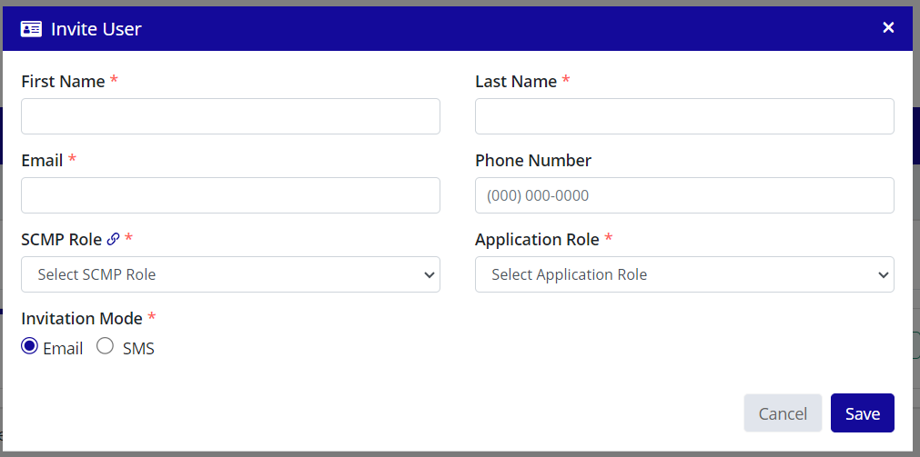
To + Invite a User that DOES NOT have a My Komatsu account:
Enter their Name, email address, and define their role within Dashboard and on the Smart Construction MarketPlace
Click Save
The user will receive an invitation to complete their registration for My Komatsu.
Once the Komatsu Distributor assigned to the company approves the account, the user will have access.

